Slide 1

Library Academy
Innovate your education
21-01-2026

Slide 2

Ontdek wat data vertellen: Aan de slag
met Machine Learning in JASP
Don van den Bergh & Johnny van Doorn
Library Academy 2026

Slide 3

Outline
Basics
What is JASP?
Regression
Machine Learning
General philosophy
K-nearest neighbors
Exercises
Notes:
3

Slide 4
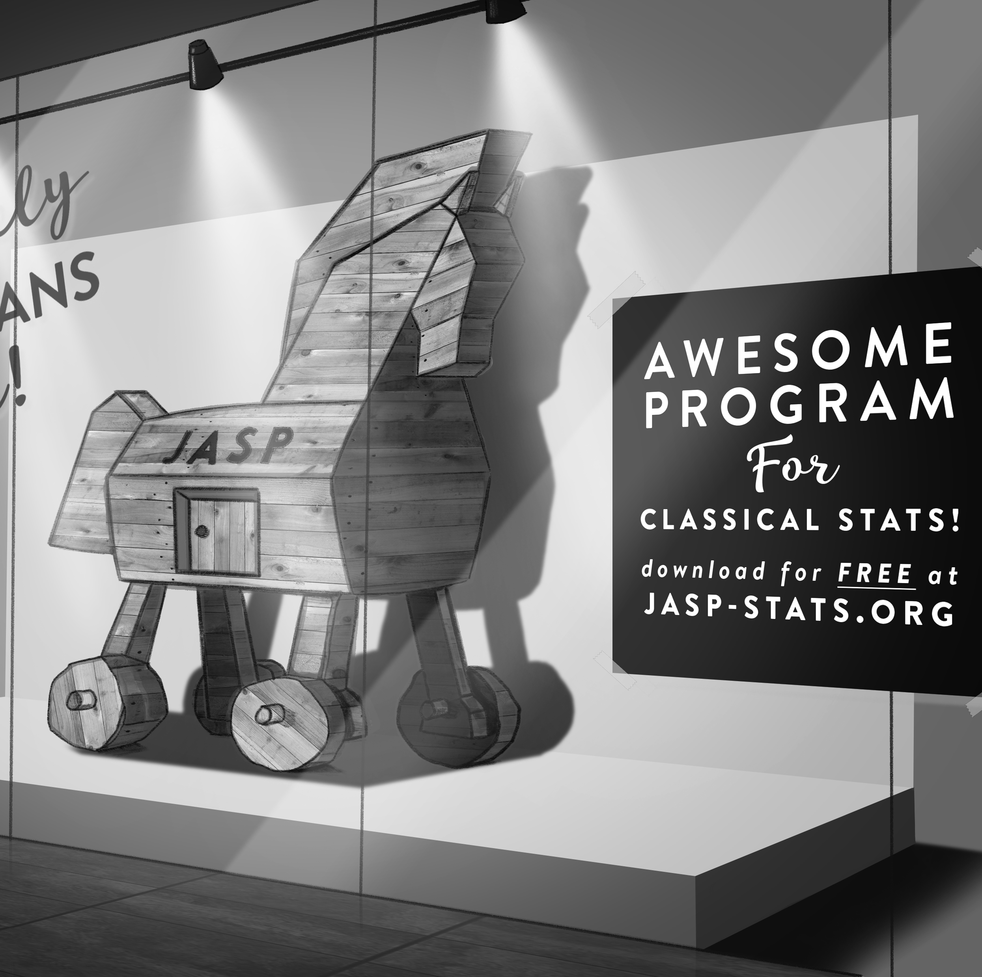
What is JASP?
Developed at UvA over the past 10 years, funded by research grants (NWO/EU)
Graphical user interface for conducting frequentist and Bayesian statistics
https://jasp-stats.org/
Open-source → forever free!

Slide 5
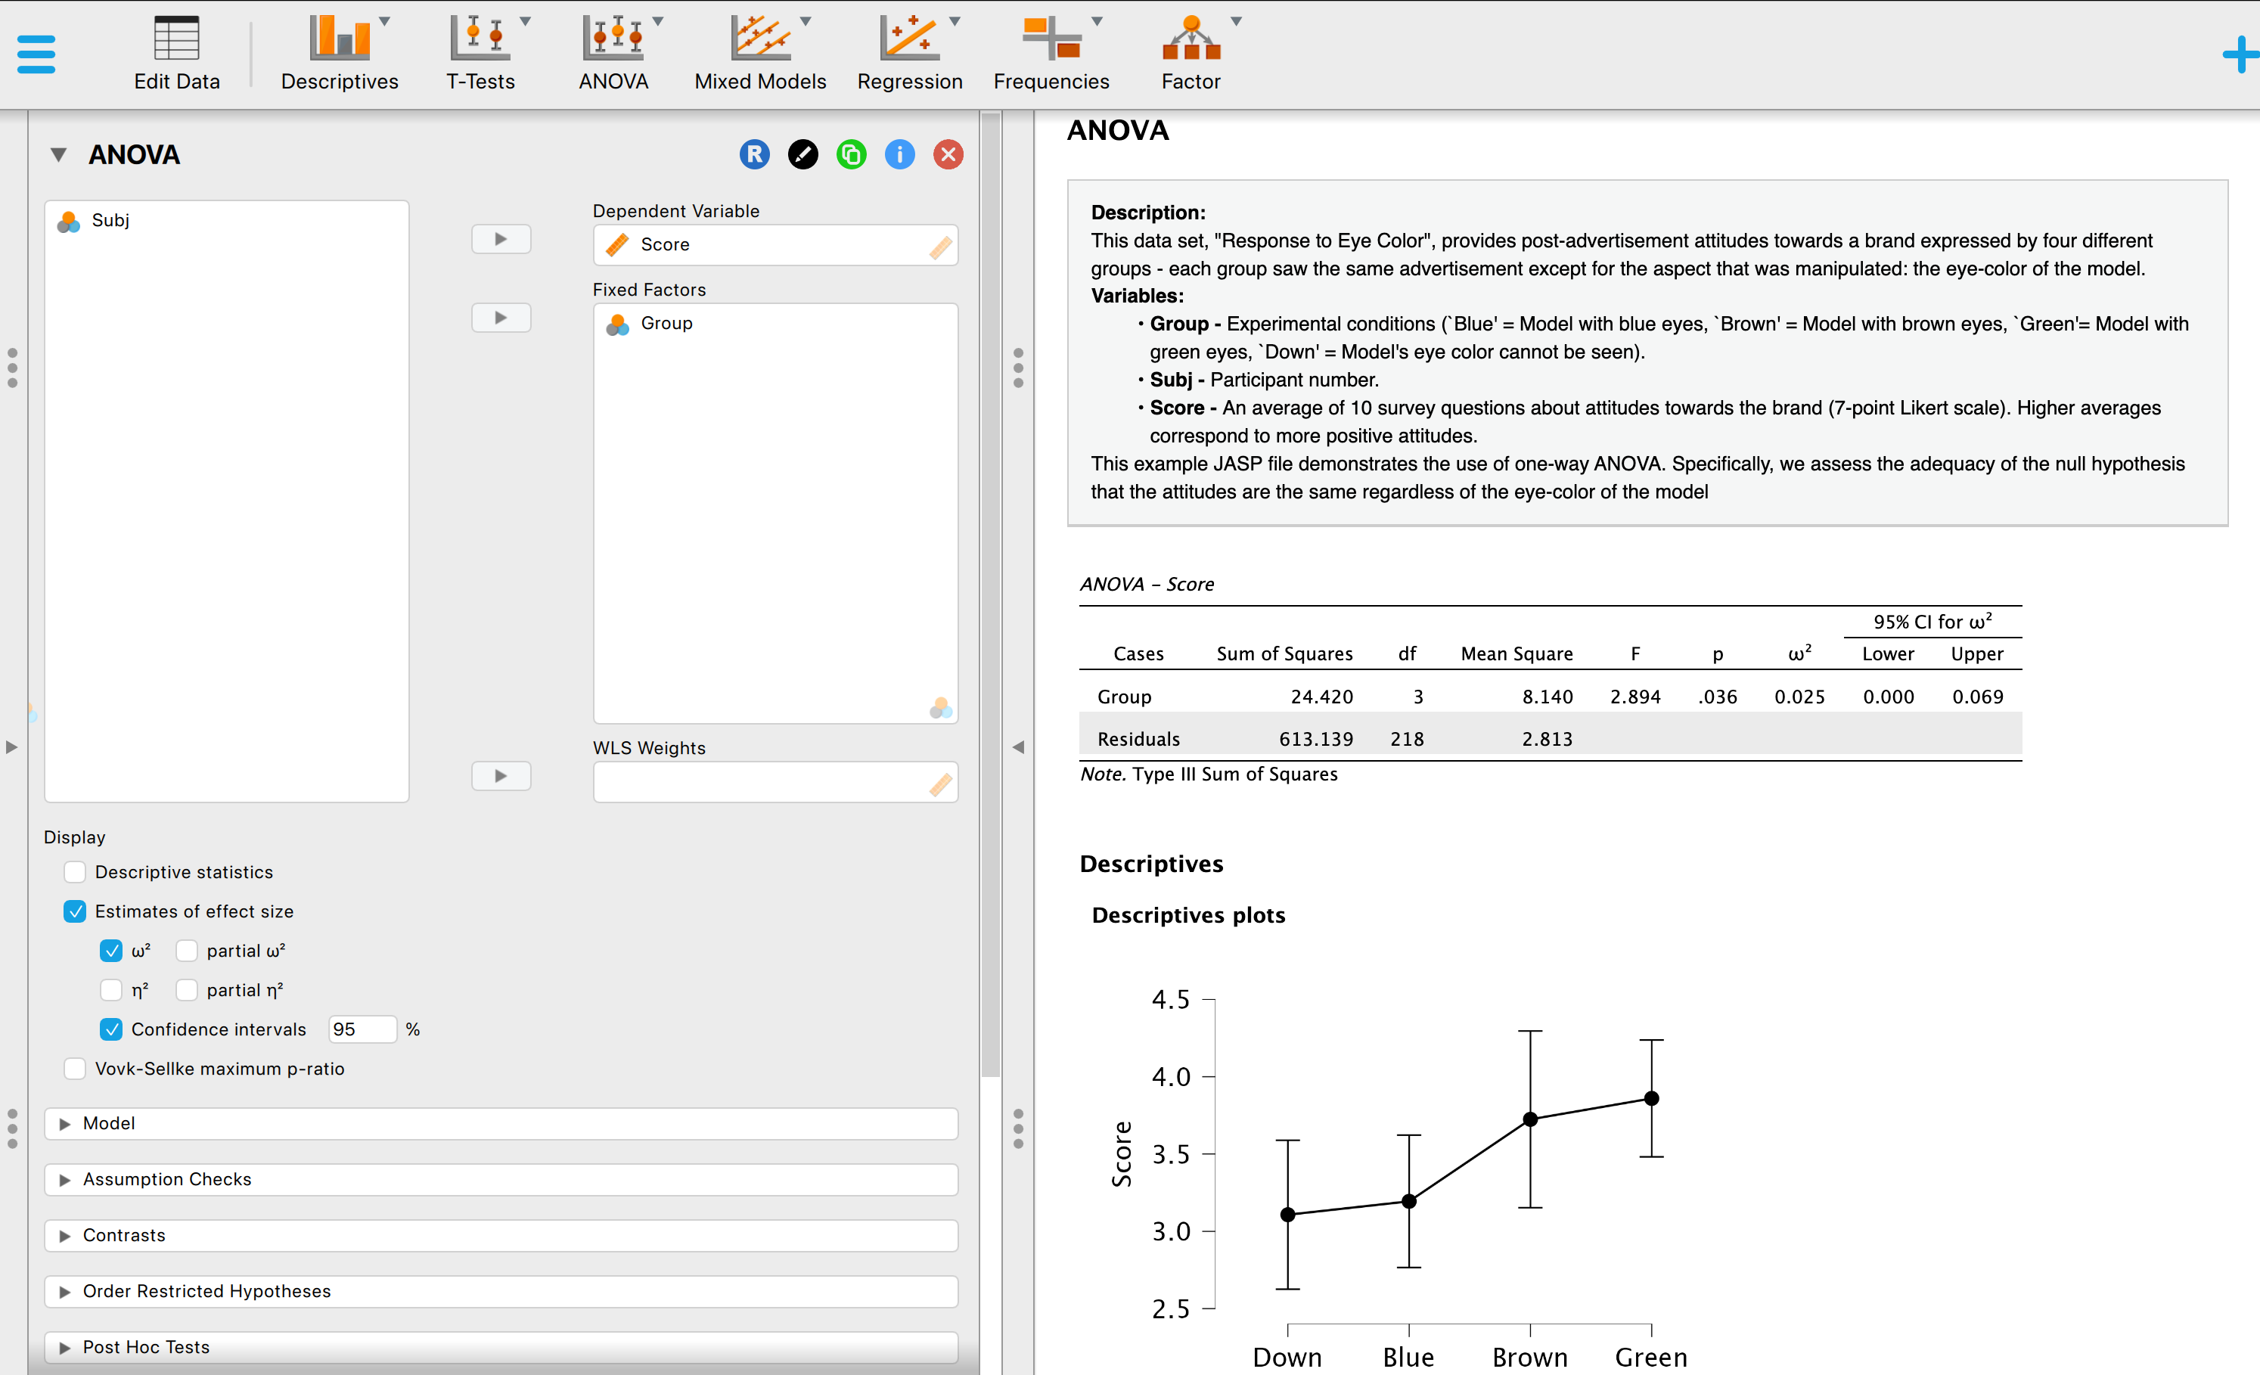
What is JASP?

Slide 6
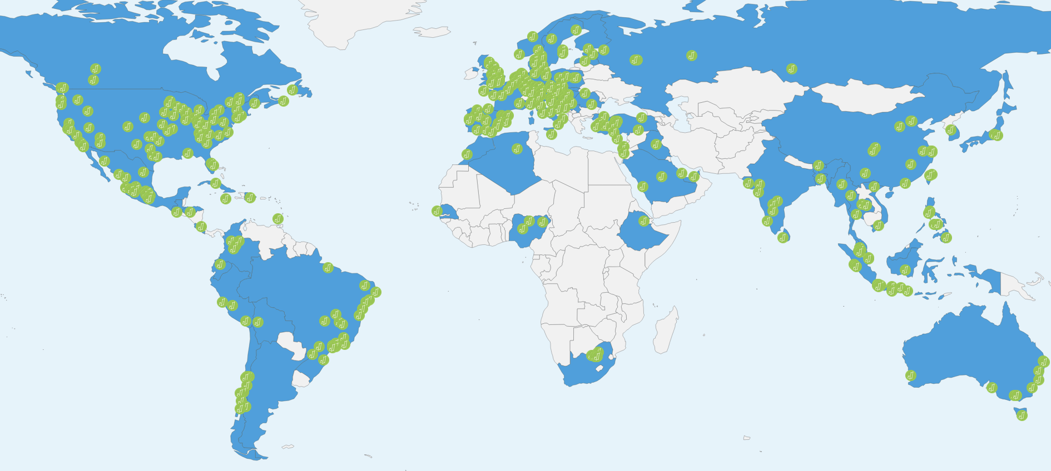
What is JASP?
Used at 374 universities across 76 countries
100,000 monthly downloads
https://jasp-stats.org/teaching-with-jasp/#worldmap

Slide 7
Features
Website overview
JASP vs. SPSS feature comparison
Data formats: .sav, .xls, .txt, .csv, .ods, .tsv, .dta, .por, .sas7bdat, .sas7bcat, and the .jasp format
APA tables
OSF integration
R console
Compute columns
Filtering

Slide 8
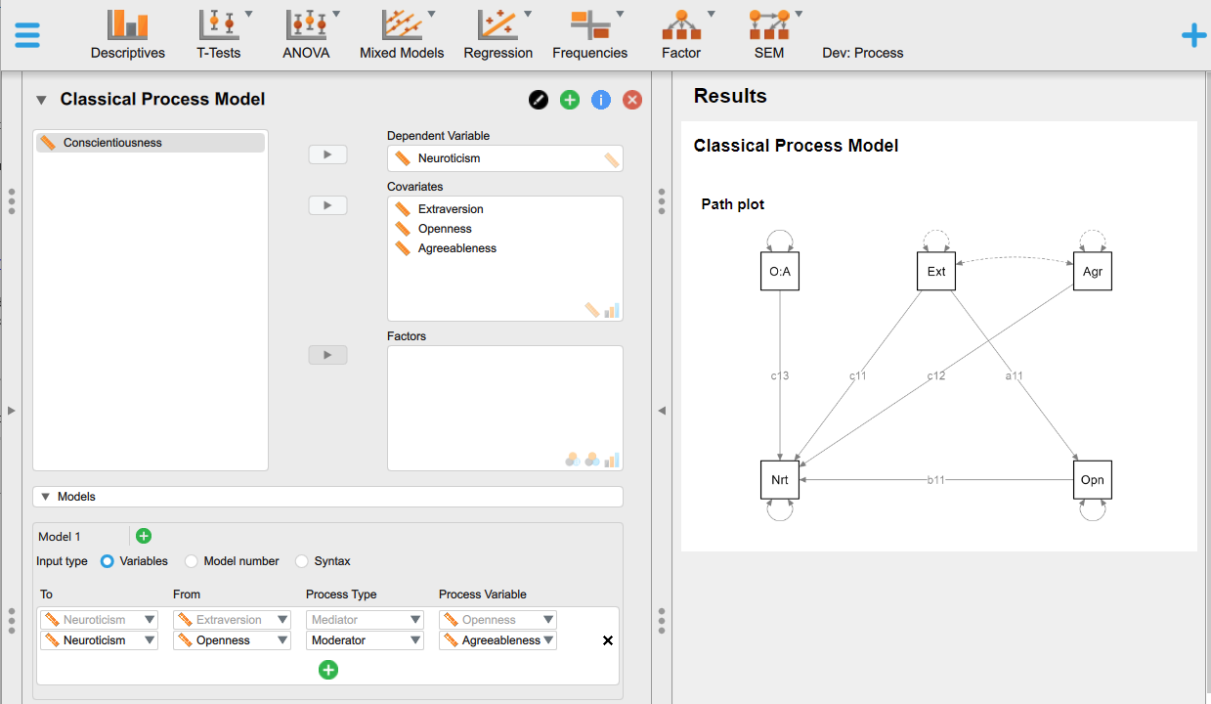
Feature Roadmap
Full syntax mode (blog about the first implementation)
Better data manipulation
Select filters

Slide 9
Other Handy Resources
The JASP Video Library
How to Use JASP – Inventory of blogs/videos/gifs for frequentist and Bayesian analyses
JASP YouTube page
Step By Step Guide: 1. Bayesian One-Way ANOVA and the full playlist
JASP on Bluesky - https://bsky.app/profile/jaspstats.bsky.social
JASP forum - https://forum.cogsci.nl/index.php?p=/categories/jasp-bayesfactor
Found a bug? Please report on Github: https://github.com/jasp-stats/jasp-issues/issues
JASP Verification Project
More JASP workshops: https://jasp-stats.org/workshop/

Slide 10
JASP Literature
The JASP Data Library
Discovering Statistics Using JASP
Learning Statistics with JASP: A Tutorial for Psychology Students and Other Beginners by Danielle J. Navarro, David R. Foxcroft, and Thomas J. Faulkenberry
Statistics of Doom by Erin Buchanan
Statistical Analysis in JASP. A Guide for Students by Mark Goss-Sampson
Quantitative Analysis with JASP open-source software by Chris Halter (amazon)

Slide 11
JASP

Slide 12
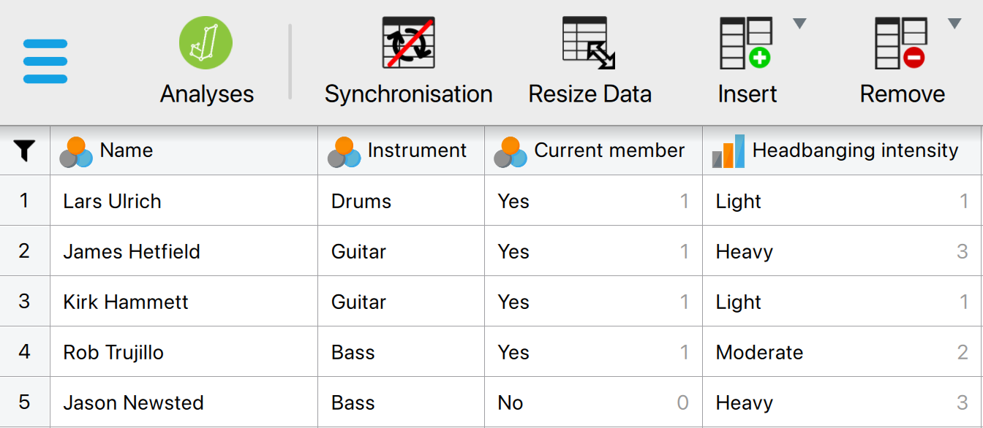
Data Management

Slide 13
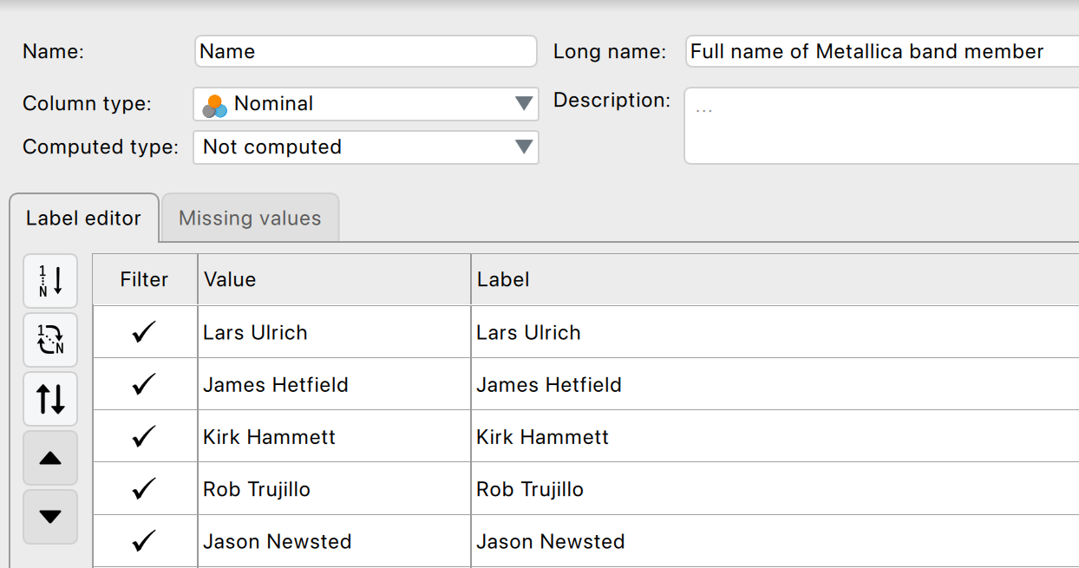
The Variable View

Slide 14



Variable Types
Scale
Numbers (e.g., 7, 0, 120, 8.5)
Nominal
Categories (e.g., ‘Control group’, ‘Experimental group’)
Ordinal
Ordered values (e.g., ‘Dislike’, ‘Neutral’, ‘Like’)

Slide 15
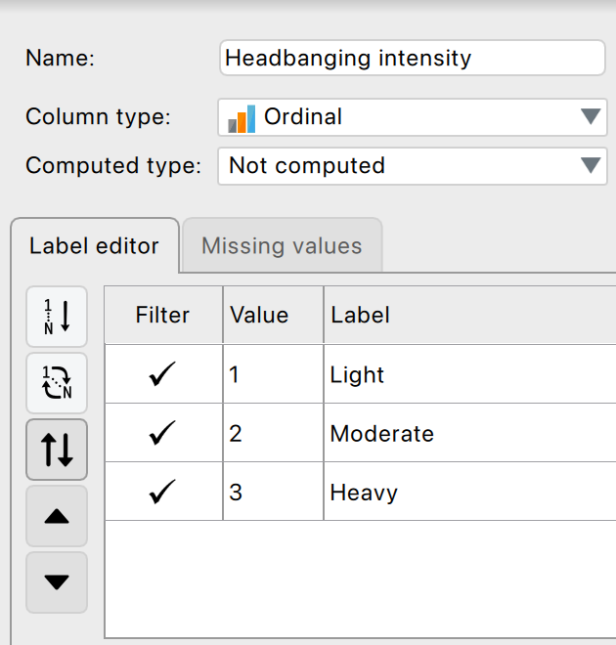
Variable Settings

Slide 16
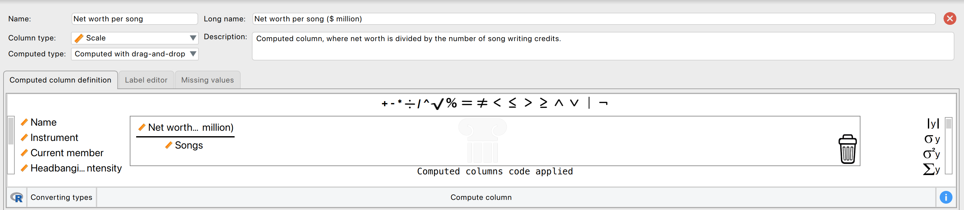

Computing a New Variable

Slide 17

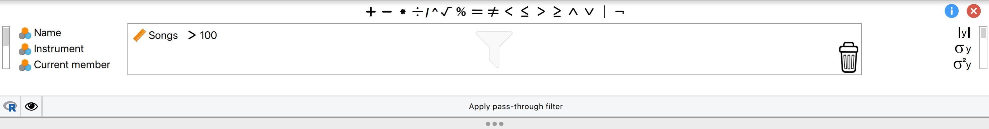
Filtering Data
Using Variable Settings
Using the Filter functionality
Drag and drop
R-mode

Slide 18
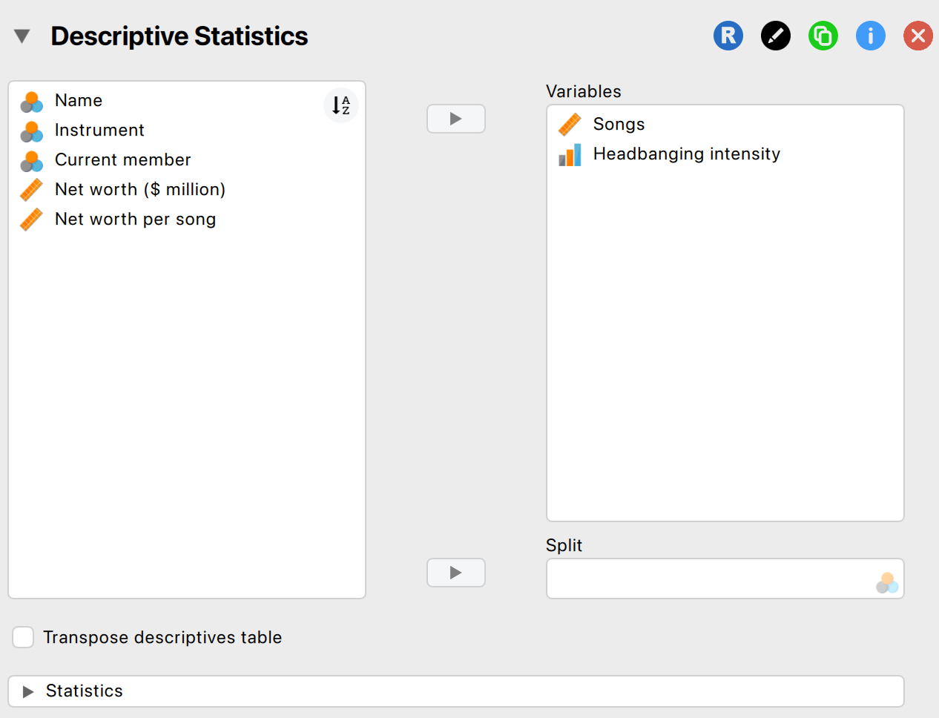
Descriptives – input window

Slide 19
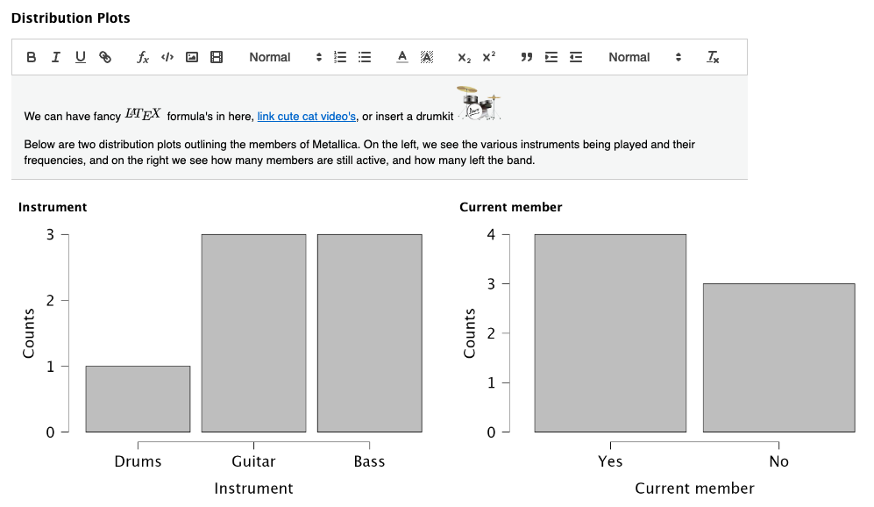
Descriptives – output window

Slide 20

JASP
Exercises!

Slide 21
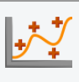


There are lots of different machine learning algorithms
Regression
Boosting
Decision tree
K-nearest neighbors
Linear
Neural network
Random forest
Regularized linear
Support vector machine
Classification
Boosting
Decision tree
K-nearest neighbors
Linear discriminant
Logistic/Multinomial
Naive Bayes
Neural network
Random forest
Support vector machine
Clustering
Density-based
Fuzzy c-means
Hierarchical
Model-based
Neighborhood-based
Random forest

Slide 22
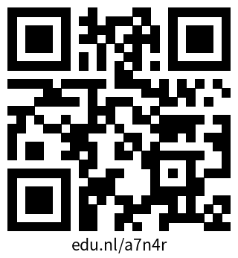
Recording of our yearly ML Workshop

Slide 23
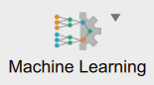



Machine learning is about finding patterns, the goal is making predictions
Machine Learning
Algorithms that learn patterns in data
Make predictions
Supervised learning
Learn patterns using human input
Make predictions for new data
Unsupervised learning
Learns patterns without human input
Find structure in data
Classification
Make predictions for categorical data
Regression
Make predictions for numerical data
Clustering
Grouping observations
Dimensionality reduction
Grouping variables

Slide 24
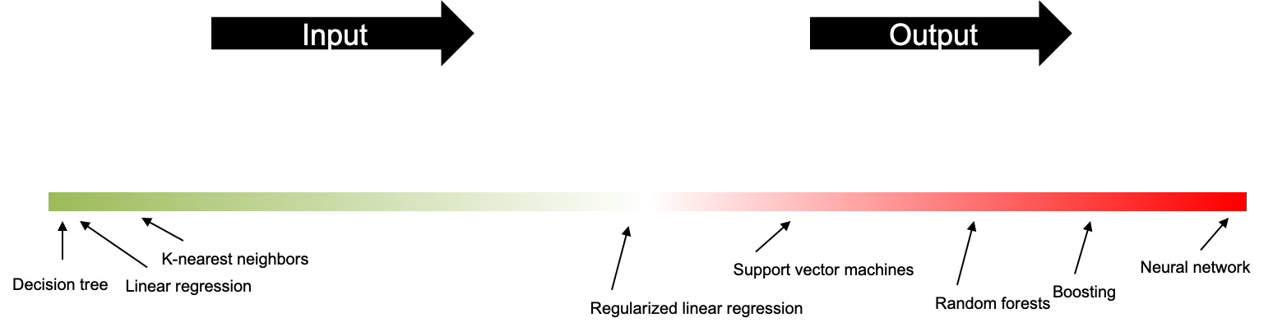
Some algorithms are ‘black boxes’
Understanding all algorithms is not the most important, understanding how to evaluate their results is
Algorithm
Features
Prediction
Explainable
Not explainable

Slide 25
Better performance (often) comes with higher complexity
Required training data
Interpretability
Model performance
e.g., linear regression
Model complexity
e.g., neural networks

Slide 26
Learning objectives for today
Train machine learning algorithms (regression, classification, clustering) using JASP
Understand how to evaluate the quality of these algorithms
Apply these algorithms to predict new data

Slide 27
Learning objectives for today
Train machine learning algorithms (regression, classification, clustering) using JASP
Understand how to evaluate the quality of these algorithms
Apply these algorithms to predict new data

Slide 28
Machine learning is about finding patterns, the goal is making predictions
Machine Learning
Algorithms that learn patterns in data
Make predictions
Supervised learning
Learn patterns using human input
Make predictions for new data
Unsupervised learning
Learns patterns without human input
Find structure in data
Classification
Make predictions for categorical data
Regression
Make predictions for numerical data
Clustering
Grouping observations
Dimensionality reduction
Grouping variables

Slide 29
A typical classification classificationworkflow
Training the classification model
Optimizing the model (optional)
Evaluating the quality of the predictions of the model
Apply the model to new data

Slide 30
You typically split your dataset in 2 or 3 parts
Training set (typically 80%): Used for training the model
Validation set: Used for optimizing the model (optional)
Test set (typically 20%): Used for evaluating the model

Slide 31

Algorithm: K-nearest neighbors
Finds the k most similar observations in the training set and uses this as a basis for prediction.
For a new observation you find the k most similar observations and take the most occurring category.

Slide 32
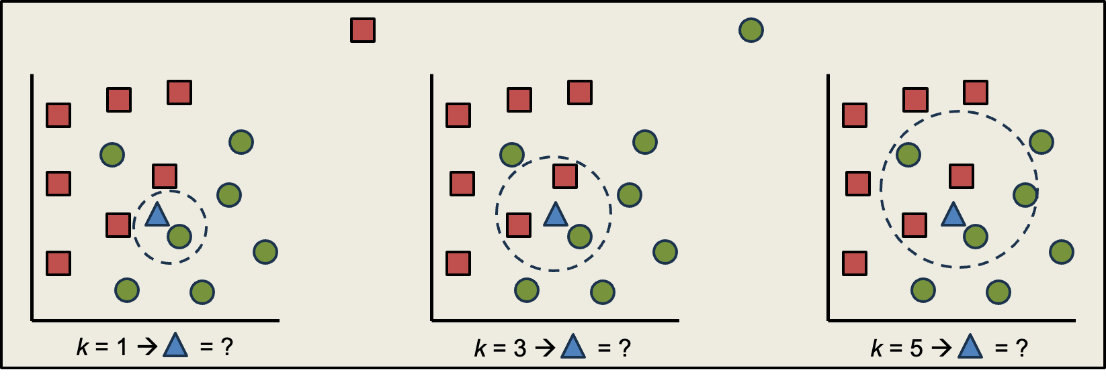
Algorithm: K-nearest neighbors
= Customer left
= Customer stayed

Slide 33
Exercise: K-nearest neighbors
Using pen and paper, draw up the data as follows:
Number of products sold on the horizontal axis,
Number of years as a customer on the vertical axis,
Use 🙂 for a customer who stayed,
Use 🙁 for a customer who left
What is your prediction with k = 1, 3 and 5 when products sold = years as customer = 1? 🙂 or 🙁?
What is your prediction with k = 1, 3 and 5 when products sold = 5 and years customer = 3 🙂 or 🙁?
Sold products | Years customer | Outcome
1 | 4 | Stayed
4 | 4 | Stayed
1 | 2 | Left
3 | 2 | Left
3 | 1 | Stayed
5 | 1 | Stayed

Slide 34
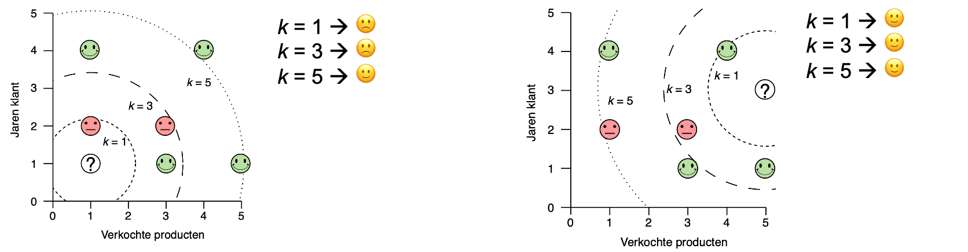
Exercise: K-nearest neighbors
What is your prediction with k = 1, 3 and 5 when products sold = years as customer = 1? 🙂 or 🙁?
What is your prediction with k = 1, 3 and 5 when products sold = 5 and years customer = 3 🙂 or 🙁?

Slide 35
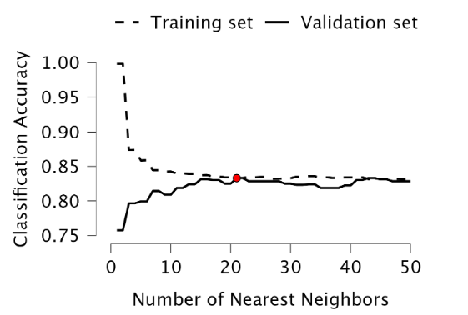
Validation: K-nearest neighbors
k = 1 is a more flexible model, it gives perfect predictions on the training set, but does not generalize well to never before seen data
k = n is a more generalized model, it gives poor predictions on the training set but generalizes better to never before seen data.
Optimal: somewhere in between.

Slide 36
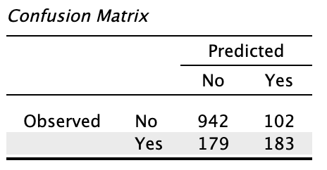
Evaluation: K-nearest neighbors
Accuracy:
Proportion of correctly classified cases
= (TN + TP) / (TN + FP + FN + TP)
= (942 + 183) / (942 + 102 + 179 + 183)
= 0.801

Slide 37
Evaluation: K-nearest neighbors
Precision:
Proportion of correctly classified positive predictions
= TP / (TP + FP)
= 183 / (183 + 102)
= 0.642

Slide 38
Evaluation: K-nearest neighbors
True positive rate (recall):
Proportion of correctly classified positive observations
= TP / (TP + FN)
= 183 / (183 + 179)
= 0.505

Slide 39
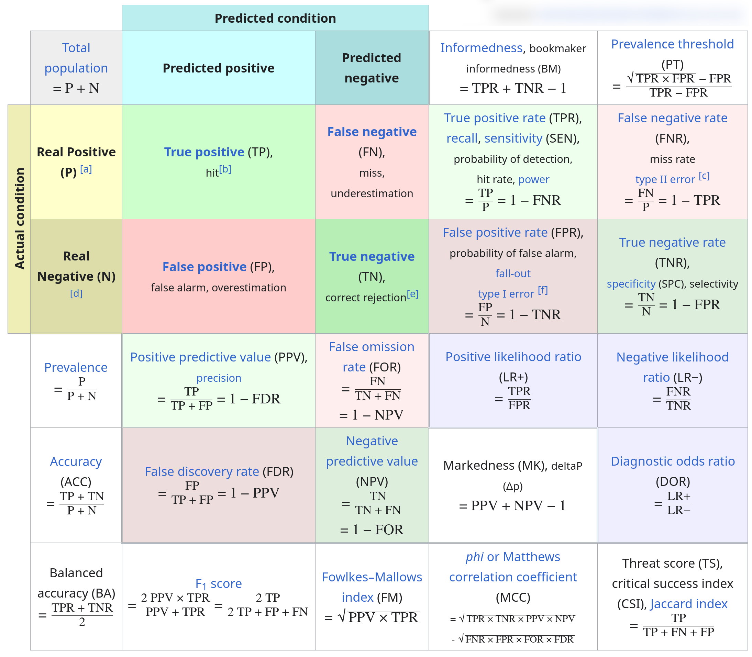
And many more...

Slide 40
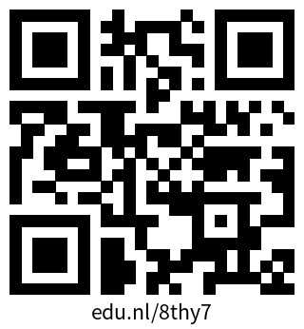
JASP
Exercises!

Slide 41
Thank you for your
attention!
Library Academy 2026

